Slide 1

Work-Study Counter
Work-Study Counter
Gandy Mendieta - Juan Torres - Daniel Rodriguez

Slide 2


Slide 3
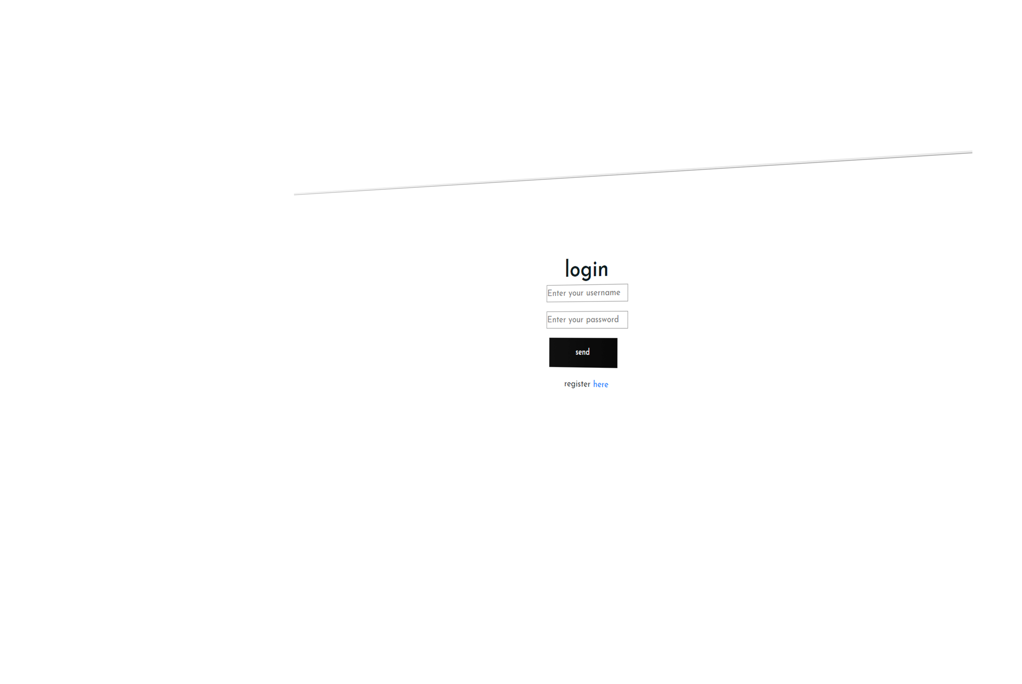



Doing an efficient work

Slide 4
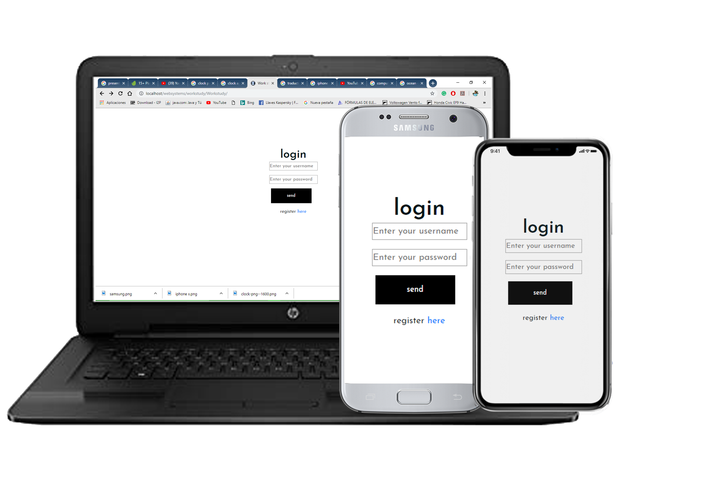
Multiplatform
Available in:
Android
Apple
Windows

Slide 5
Benefits of using this WSC

